Slide 1
IDIOMS

Slide 2
An idiom is a word or phrase which means something different from its literal meaning. Idioms are common phrases or terms whose meaning is changed, but can be understood by their popular use. ... But people also need to learn idioms separately because certain words together or at certain times can have different meanings.
What is an idiom?!

Slide 3
Now…..

Slide 4
Let’s do some IDIOMS!!!!!!!!

Slide 5
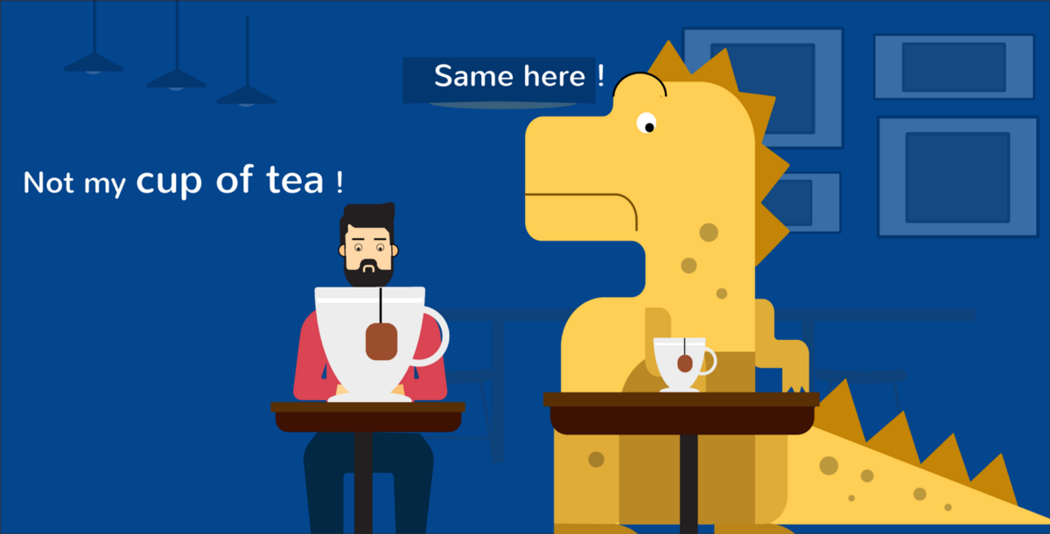
Something you do not like or enjoy.

Slide 6
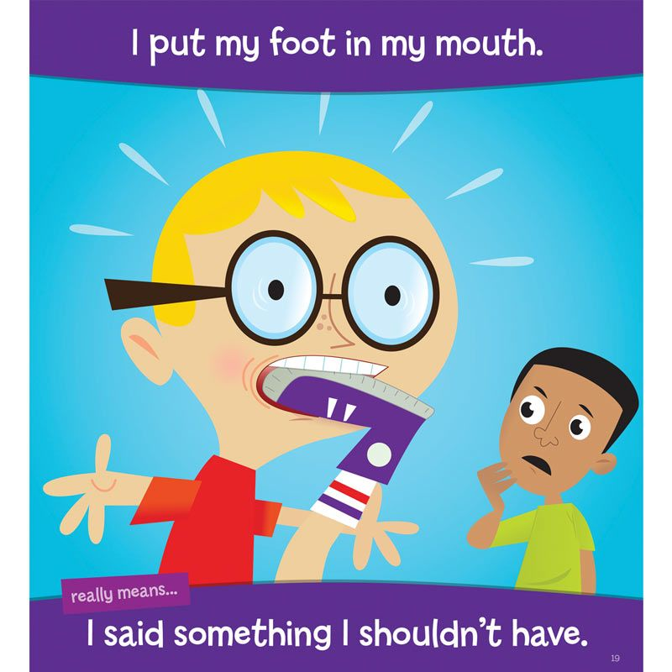

Slide 7

Someone who you love.

Slide 8
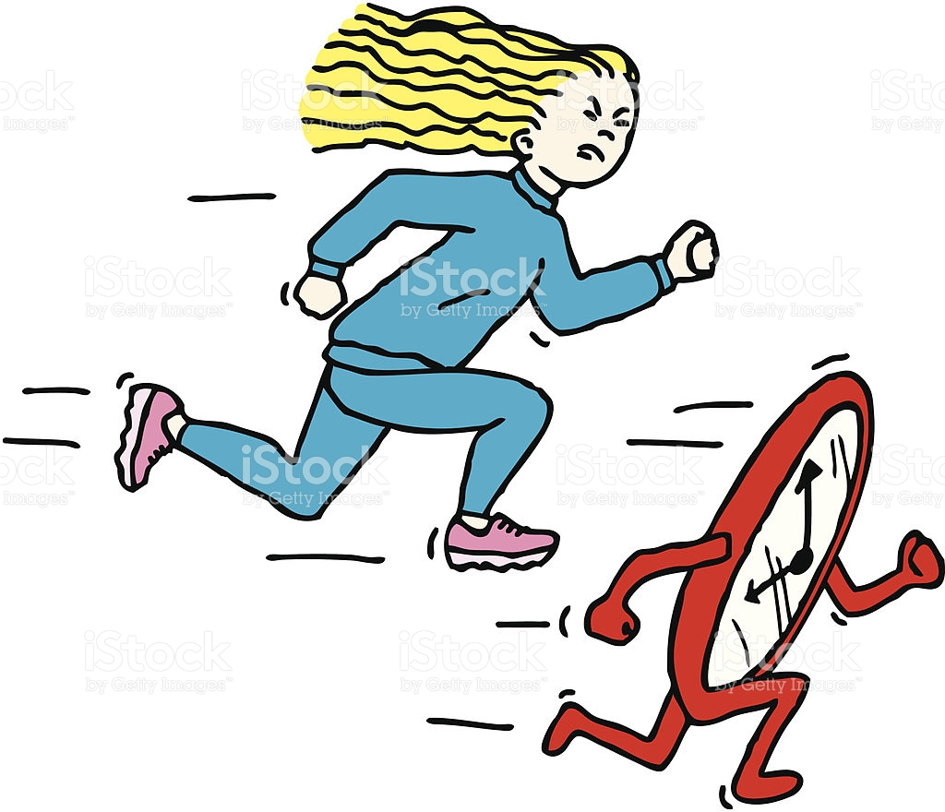
race against the clock
An attempt to accomplish something in a short amount of time

Slide 9
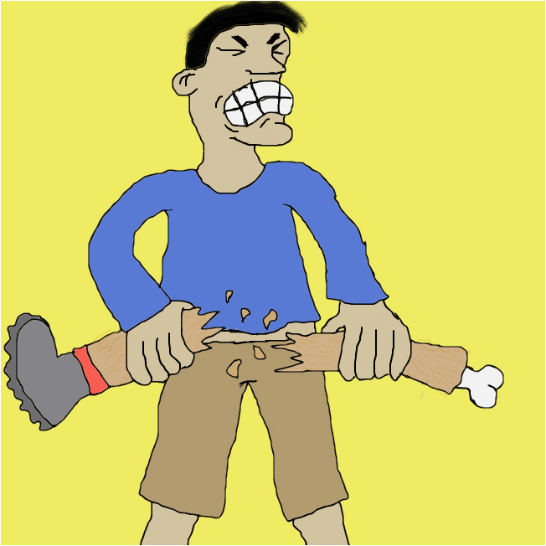
Break a leg
Good luck!

Slide 10

Someone that closely imitates or mimics another.

Slide 11
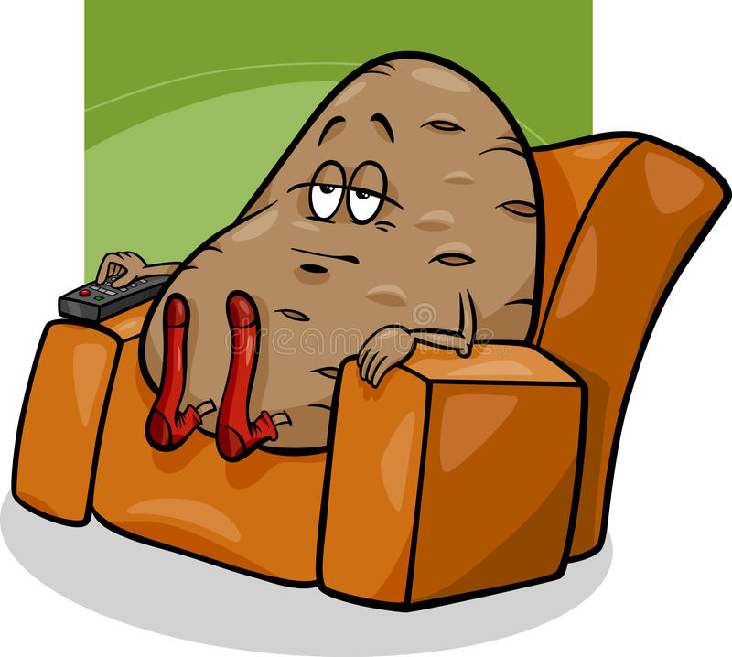
Couch potato
A person who spends much time sitting or lying down, usually watching television.

Slide 12
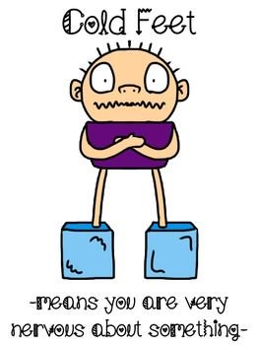

Slide 13
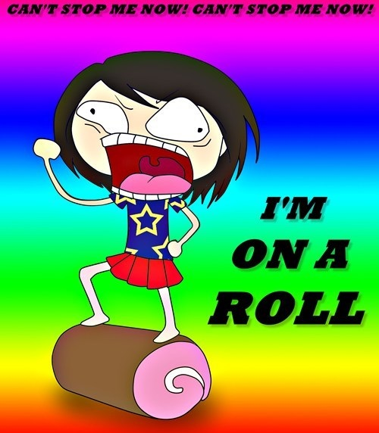
Succeeding in what you have been doing over a period of time.

Slide 14
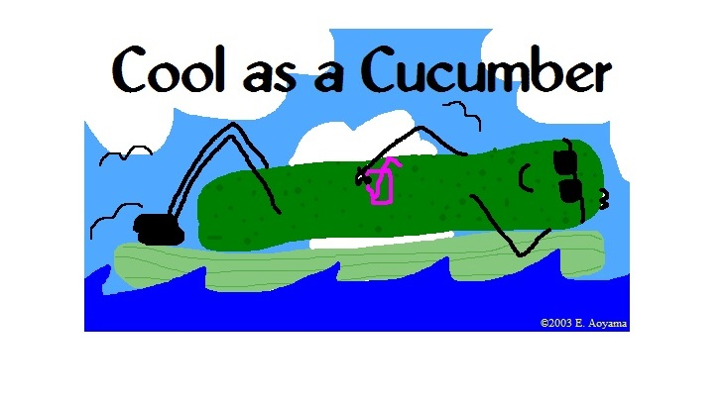
Calm and composed, especially in times of stress.

Slide 15
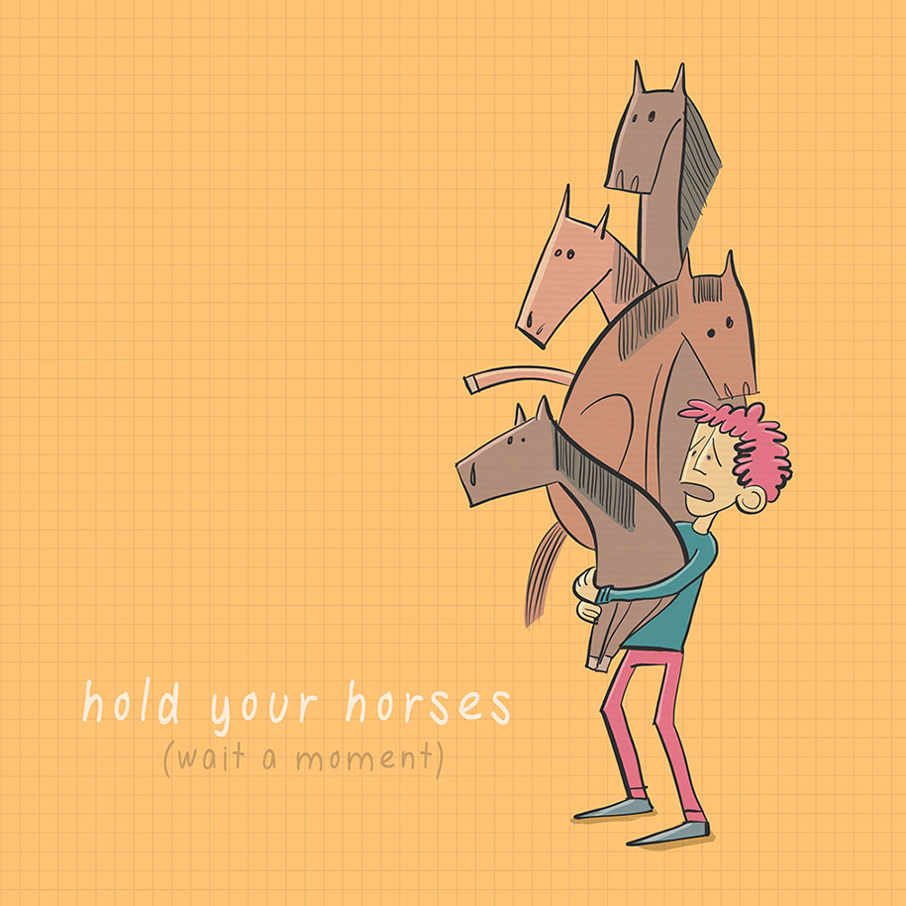
Stop what you're doing (often because you are moving too quickly or thoughtlessly).

Slide 16
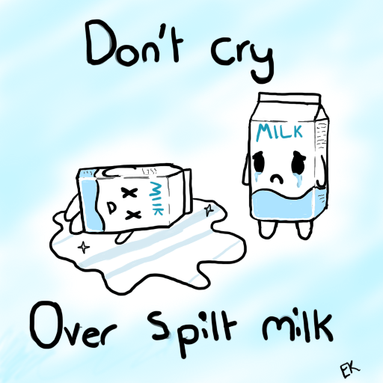
Don’t cry over the little things

Slide 17

To depart; to begin one's journey, especially on a road trip; to leave for home.

Slide 18
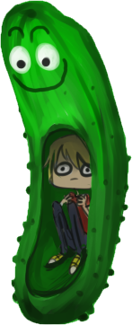
In a pickle (腌黄瓜)
In a bad situation.

Slide 19
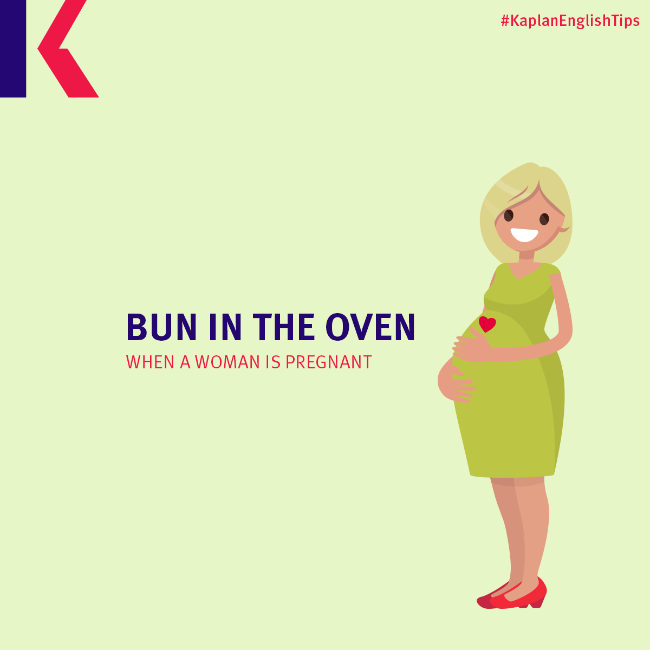

Slide 20
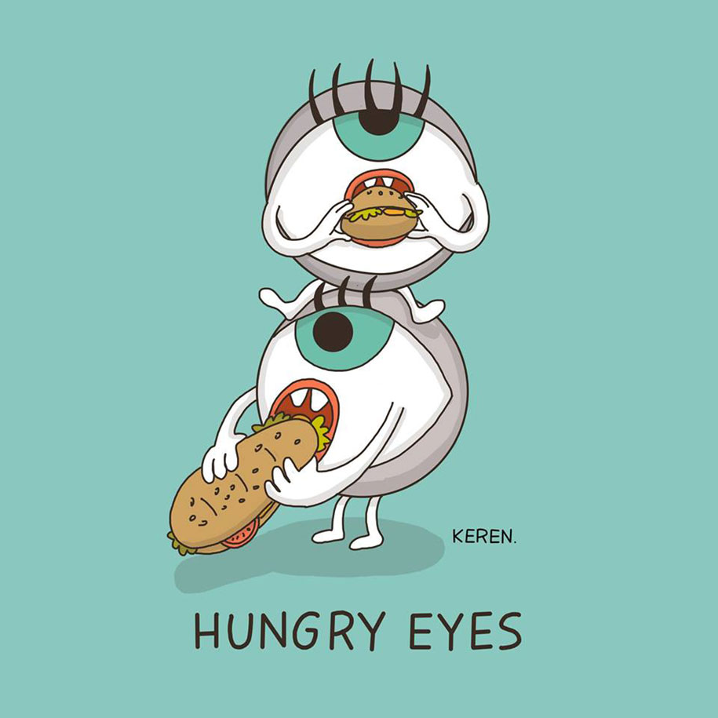
You see it, you WANT IT!

Slide 21
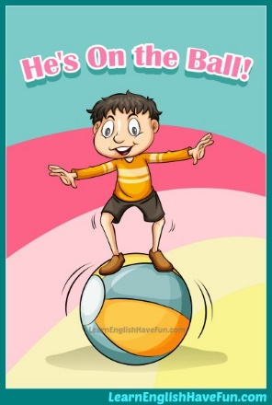
Being on top of your tasks/work schedule

Slide 22
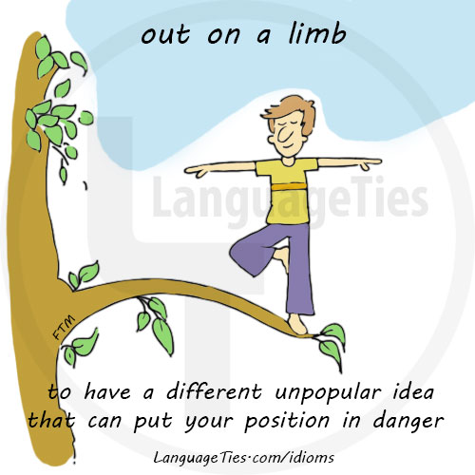

Slide 23
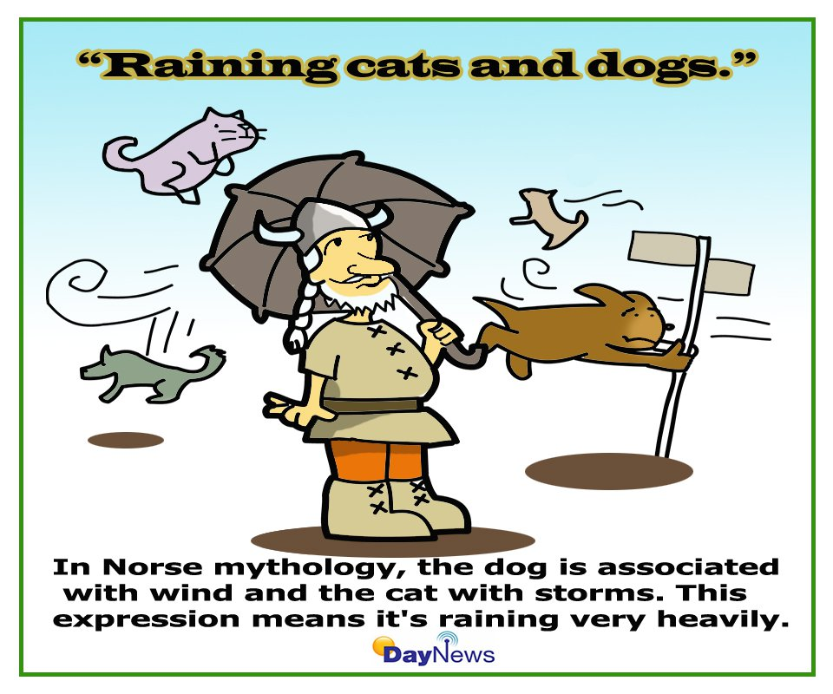
Heavy rain

Slide 24
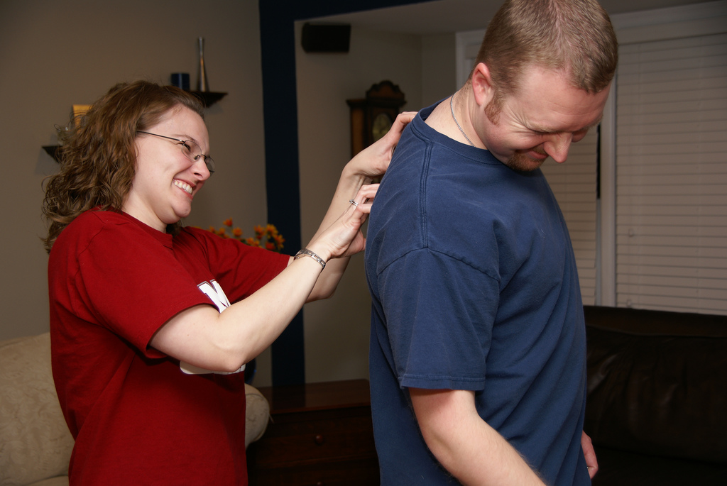
You scratch my back, I’ll scratch yours
You help me, I’ll help you.

Slide 25

To betray someone's confidence, trust.

Slide 26
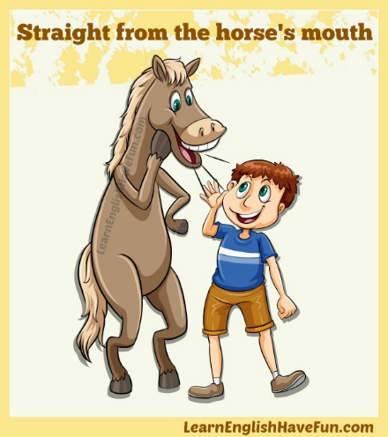
From the original or most reliable source.

Slide 27
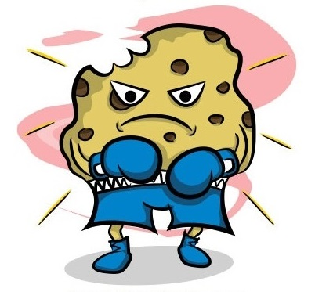
One tough cookie
A strong, determined person who is not easily intimidated, discouraged, or defeated.

Slide 28

To annoy or irritate someone.

Slide 29

To be sick

Slide 30
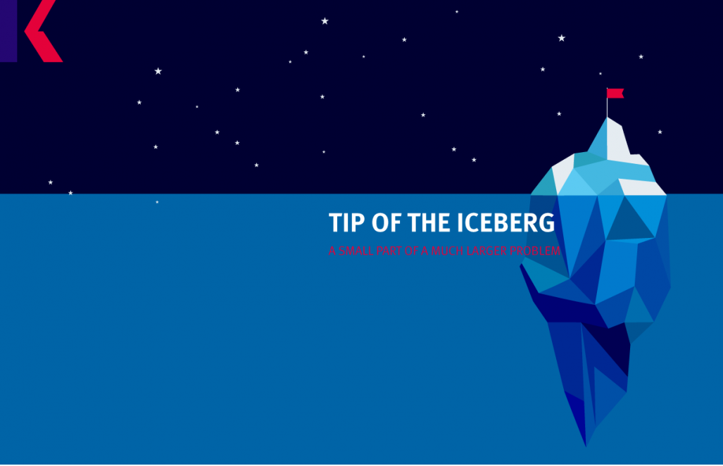

Slide 31


Slide 32
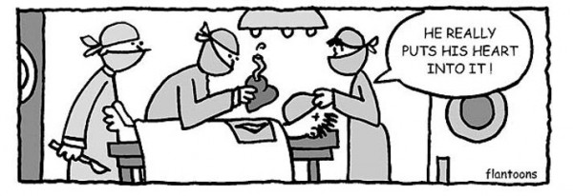
To make a lot of effort to do something

Slide 33
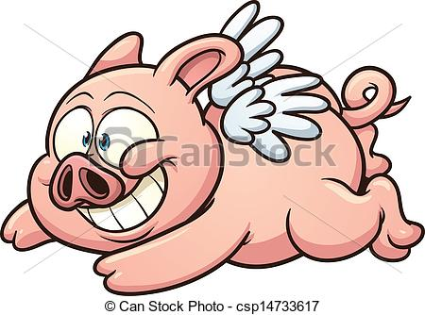
When pigs fly
It will never happen!

Slide 34
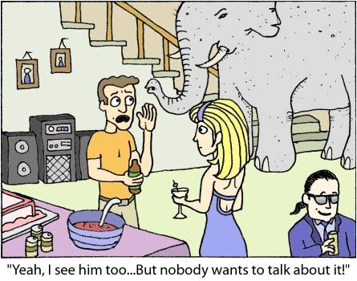
The Elephant in the room
A major problem or controversial issue that is obviously present but avoided as a subject for discussion because it is more comfortable to do so

Slide 35
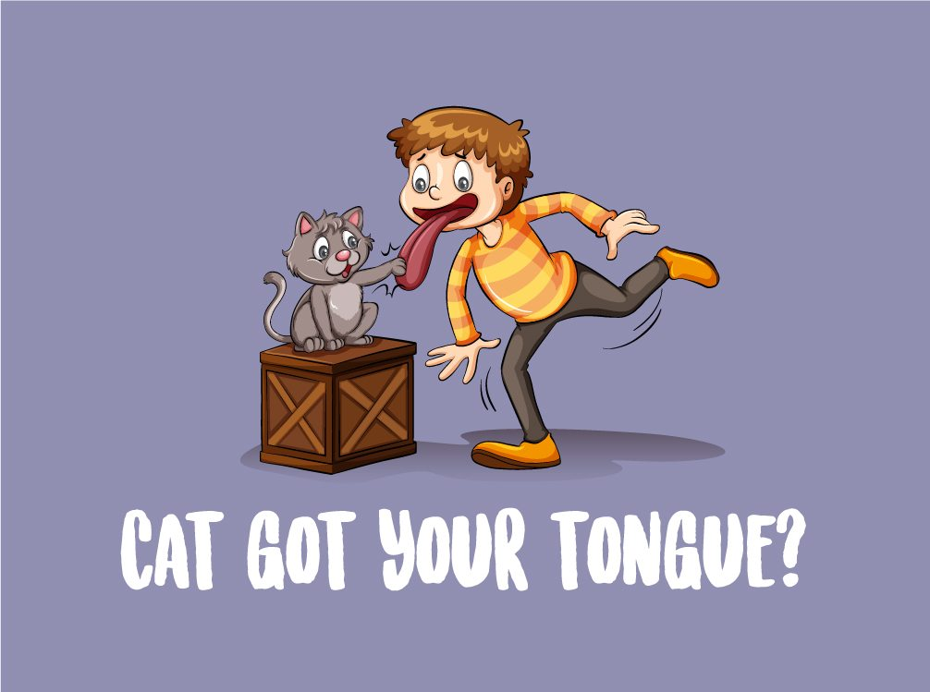
Used when someone has nothing to say.

Slide 36
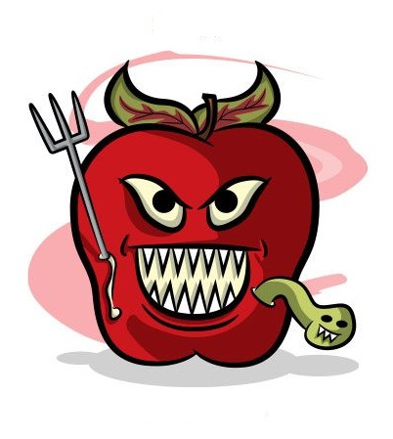
Bad apple
A troublemaker

Slide 37
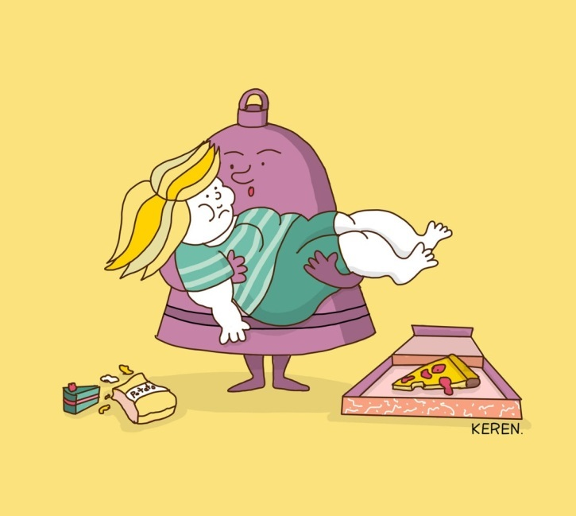
Saved by the bell
Someone or something is rescued from a dire (bad) outcome by a timely occurrence, generally speaking, at the last possible moment

Slide 38

Time goes by very quickly.

Slide 39
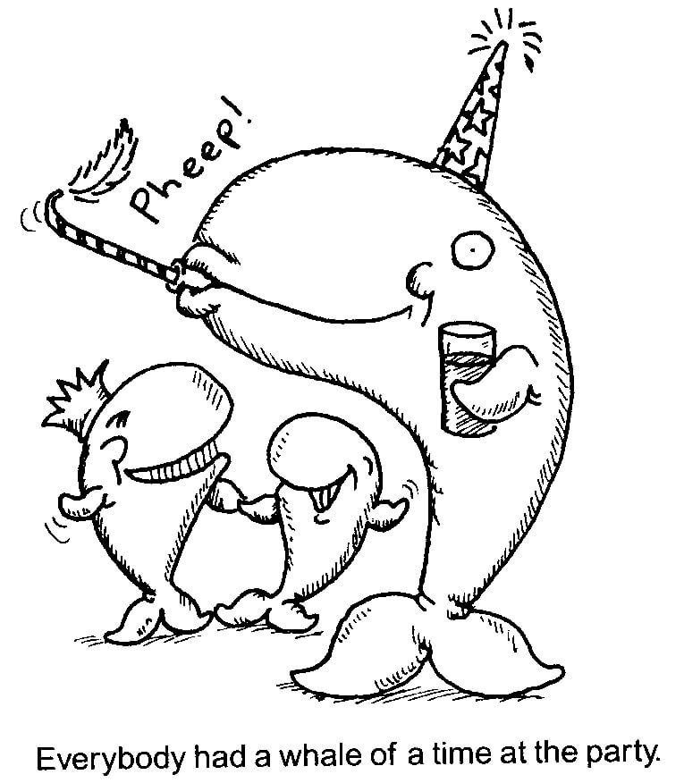
Whale of a time
To enjoy yourself very much

Slide 40
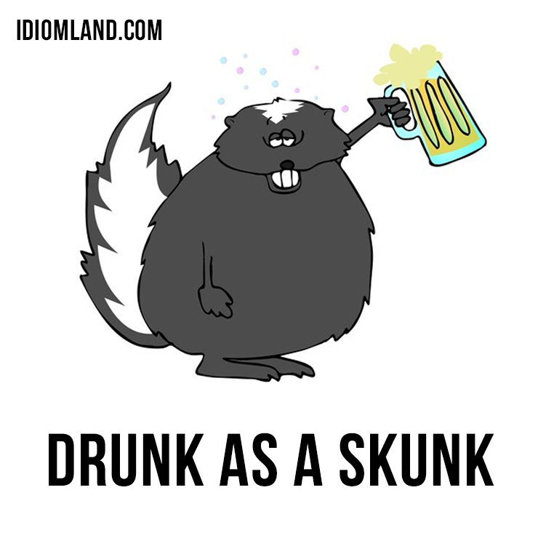
Very drunk

Slide 41
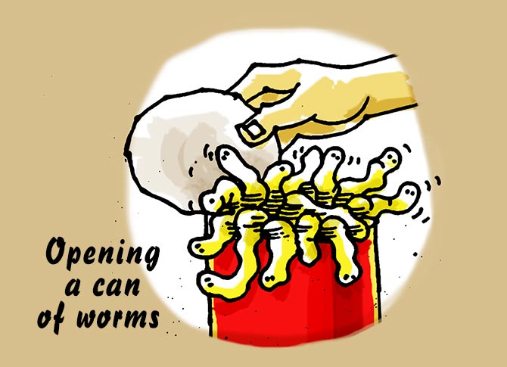
Doing something that will only create more problems

Slide 42
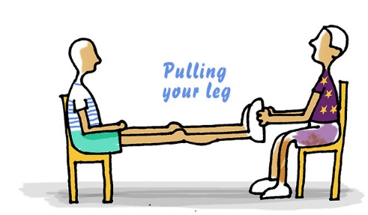
To tease or play a joke on someone

Slide 43
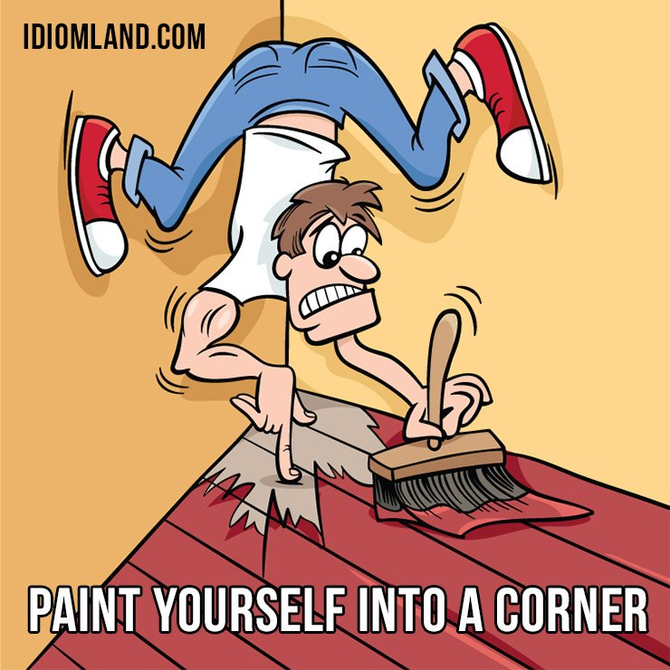
To do something which puts you in a very difficult situation

Slide 44
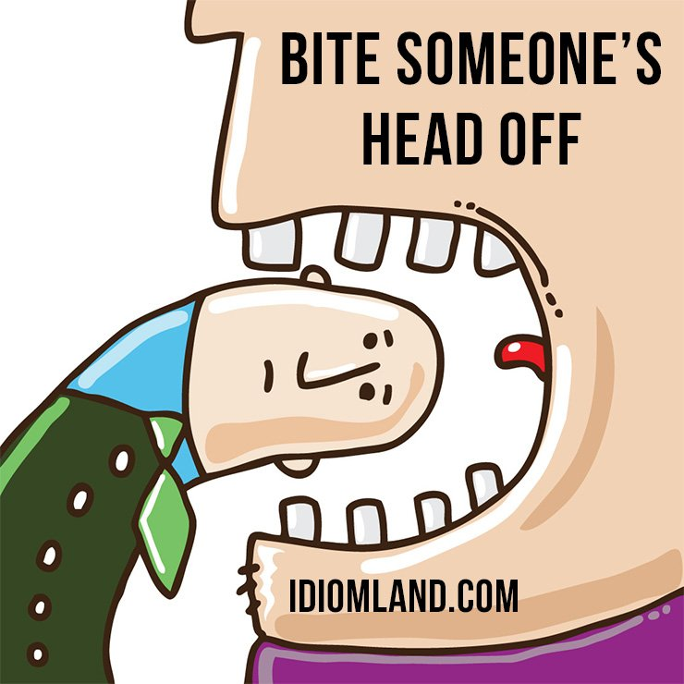
To speak to someone in an angry way

Slide 45

To be fully armed, having many weapons

Slide 46

The activity of looking at the goods displayed in shop windows, especially without intending to buy anything

Slide 47
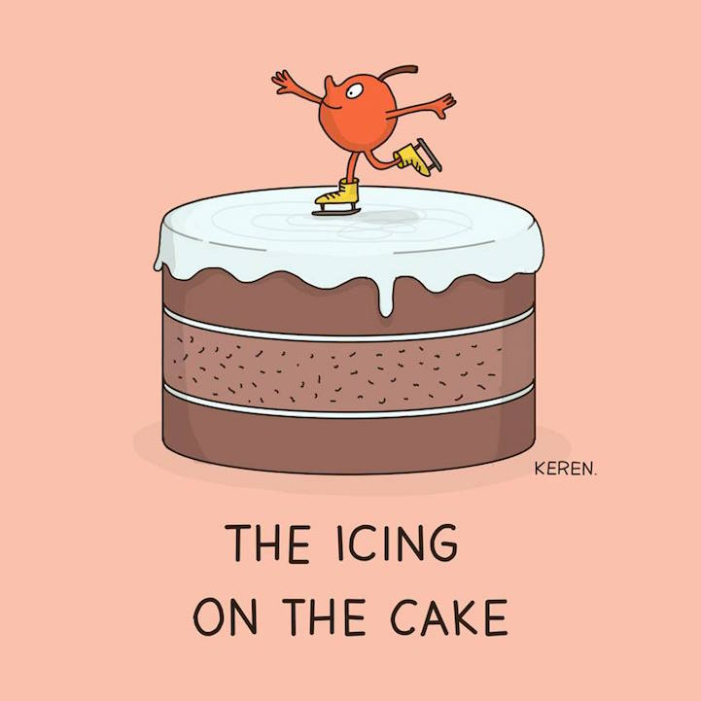
An additional benefit or positive aspect to something that is already considered positive or beneficial.

Slide 48

Letting thoughts come into your head freely, without directing them or concentrating on anything

Slide 49
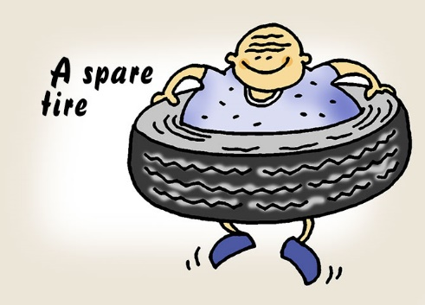
Referring to the fat accumulated around his/her waistline

Slide 50
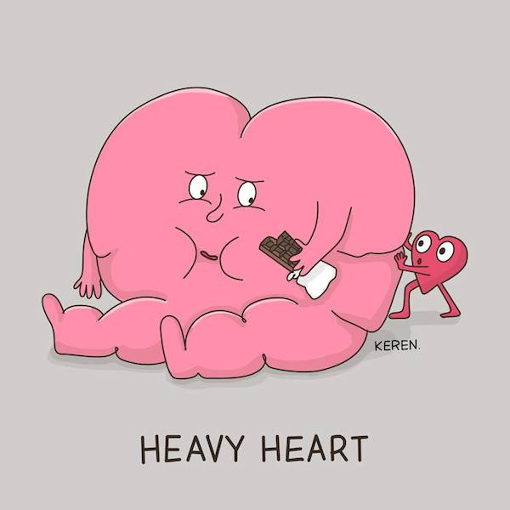
To tell someone something in a sad or miserable state

Slide 51
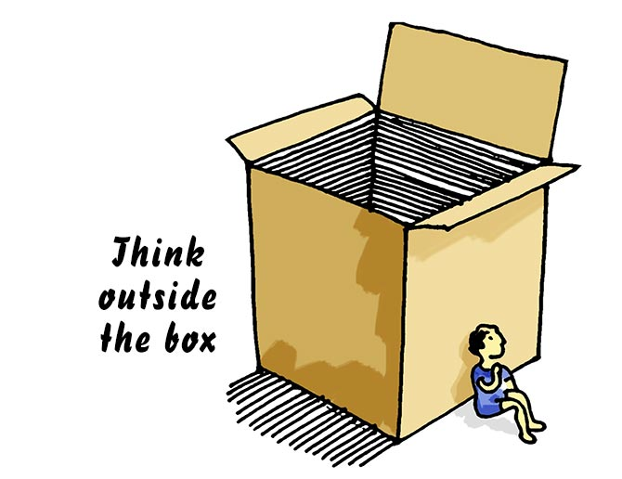
To think creatively or in an original way

Slide 52
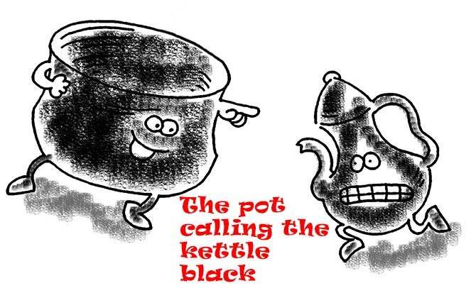
Blaming someone for something that you too have done

Slide 53

There are plenty more fish in the sea
used to tell someone whose relationship has ended that there are many other people that they could have a relationship with

Slide 54
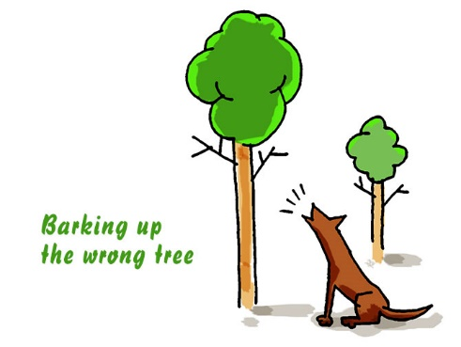
To falsely accuse a person of doing something or to pick up the wrong person to do something

Slide 55
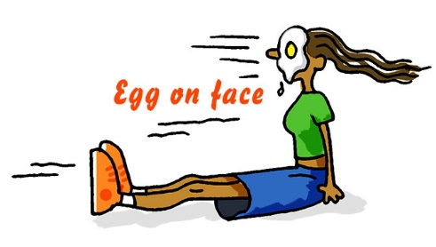
To be embarrassed, look foolish/stupid or be caught in an awkward moment because of something that you have done.

Slide 56
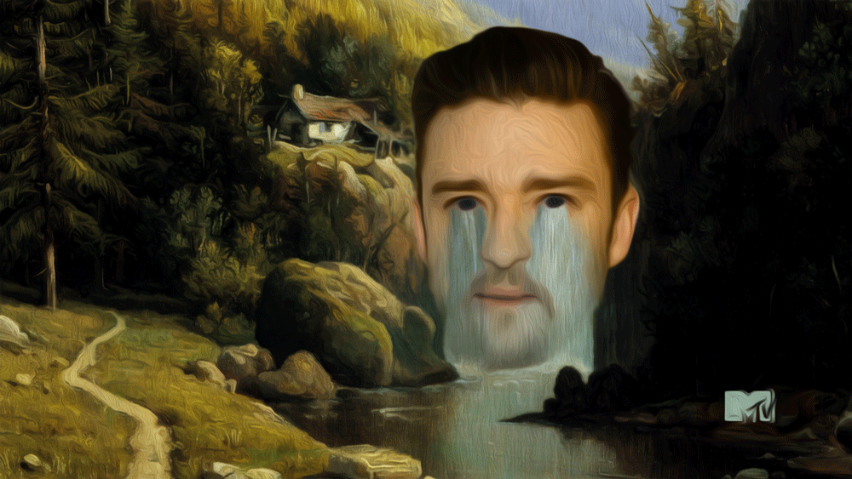
Cry me a river
Said sarcastically (讽刺) to someone whose whining, complaints, or tears fall on unsympathetic ears.

Slide 57
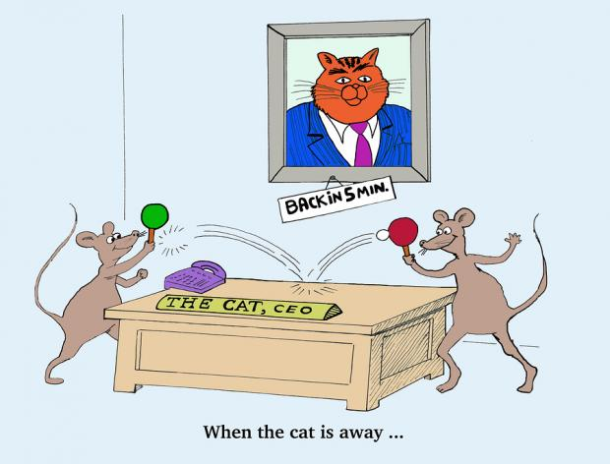
When the cat's away the mice will play
When the person who is in charge of a place is not there, and the people there behave badly

Slide 58
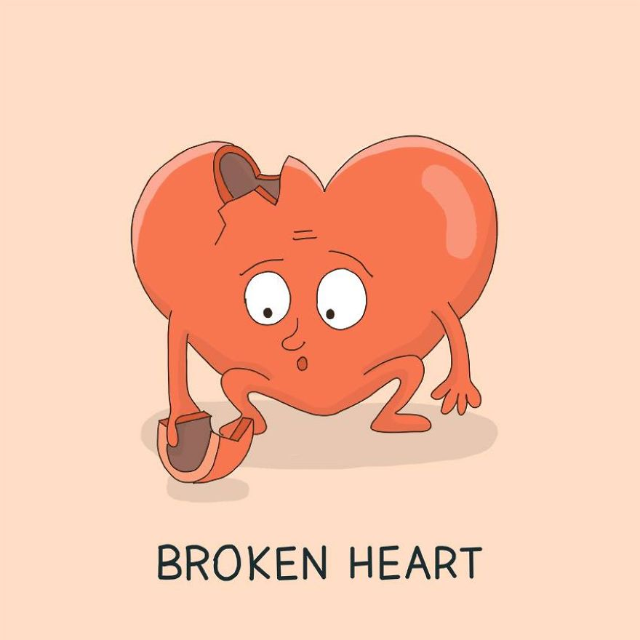
Great sadness felt when you experience a great tragedy in your life.

Slide 59
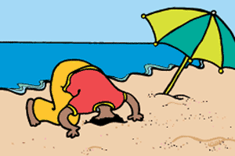
Head in the sand
To avoid, or try to avoid, a particular
situation by pretending that it does not exist.

Slide 60
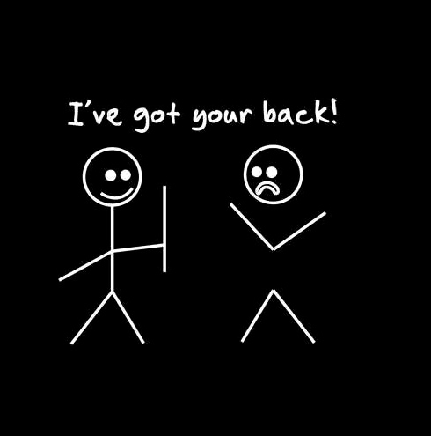
I’m here to help!

Slide 61
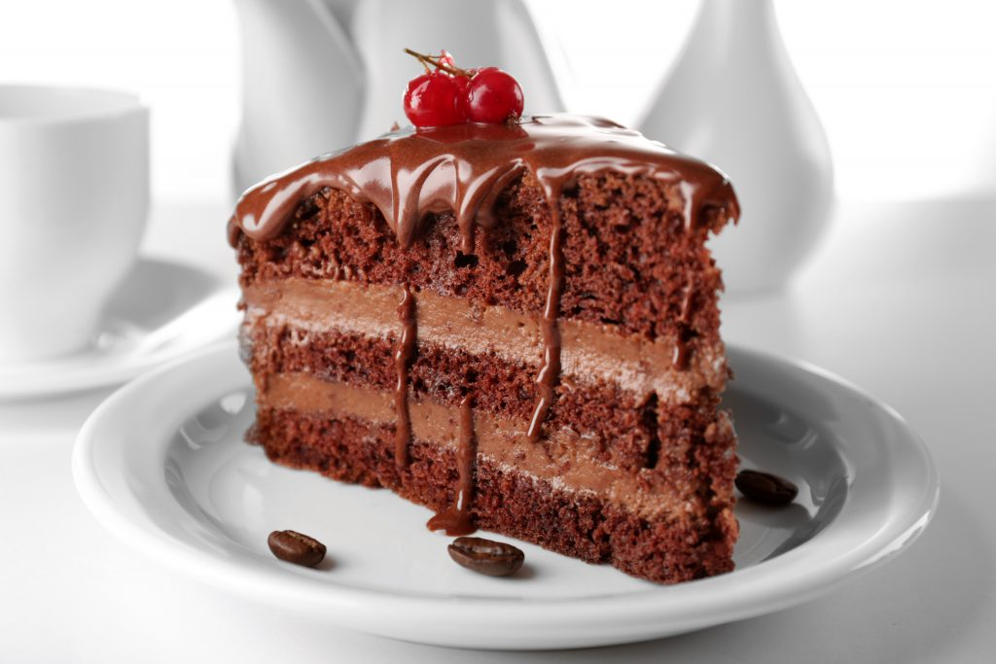
A piece of cake.
Easy

Slide 62
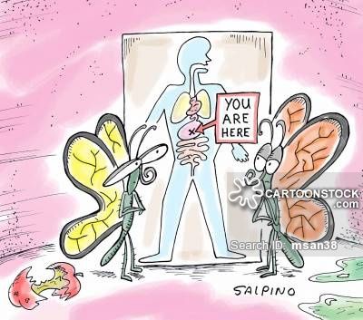
Butterflies in your stomach
To have anxious and have a nervous feeling in your stomach

Slide 63
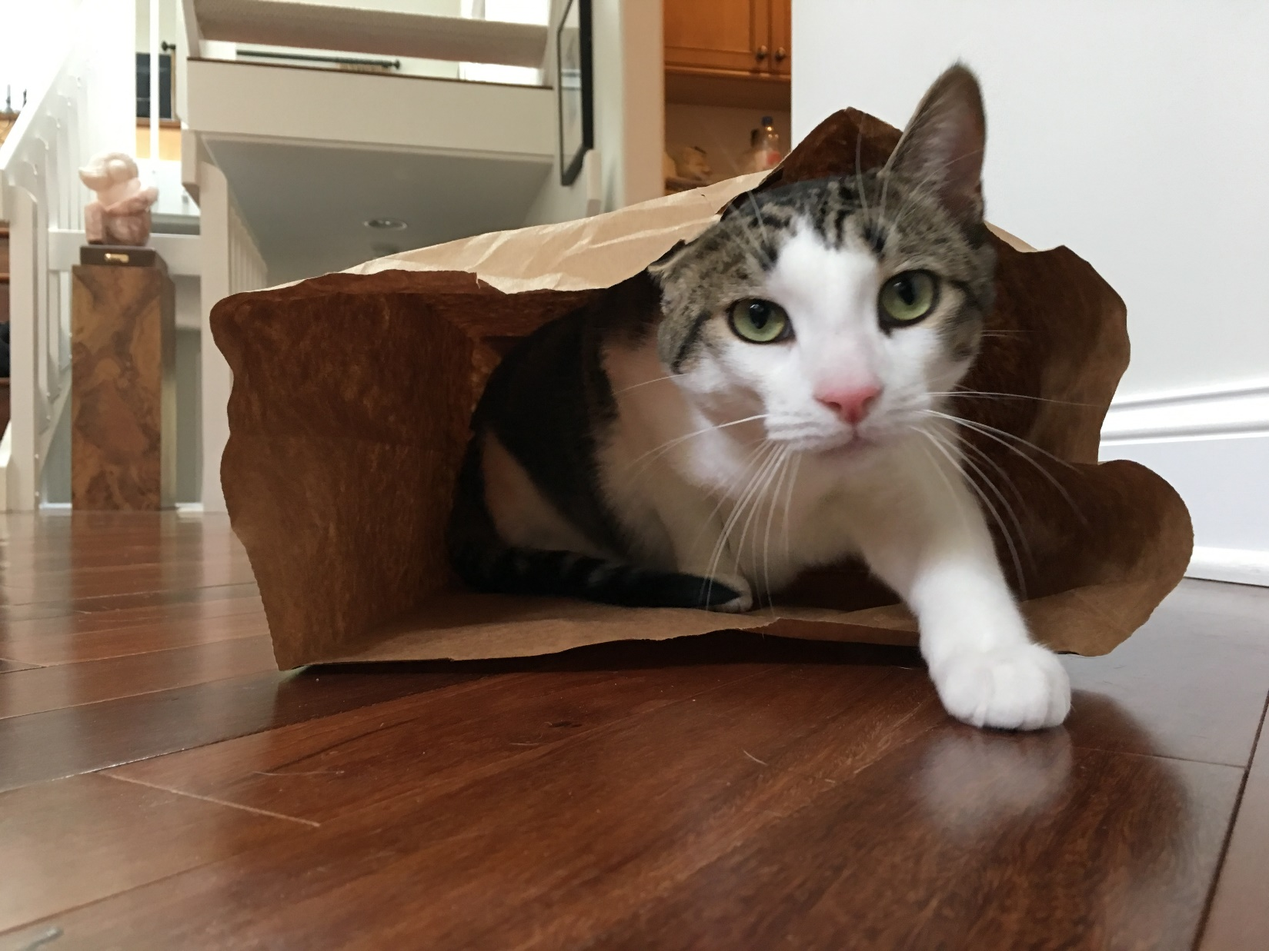
The cats out of the bag
To say something that was a secret.

Slide 64

Cash cow
A business, investment, or product that provides a steady income or profit

Slide 65
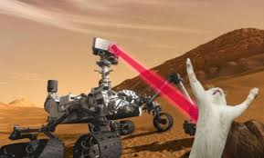
Curiosity killed the cat
Being curious can get you into trouble.

Slide 66
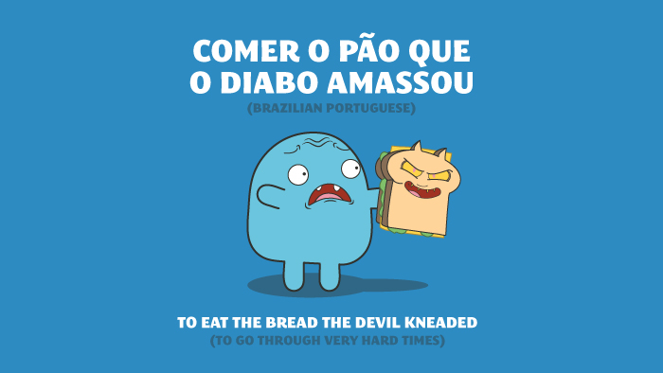

Slide 67
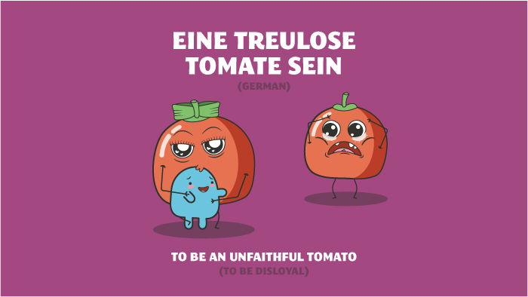

Slide 68


Slide 69


Slide 70


Slide 71
And finally………..

Slide 72


